Slide 1
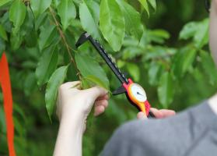
The Climate Lab
Lesson 1

Slide 2
What is the Climate Lab?
The Climate Lab is part of the world-wide effort to understand and combat human-caused climate change.
You and hundreds of other students around the country will be working with scientists this spring to take measurements in the field as part of that effort.

Slide 3
How will your field work fit in?
The Climate Lab lessons you take this week will help you make the connection. You’ll learn:
Information about climate change in your area and around the world
Why long-term data sets are important, and how they help us see things not visible in other ways
What measurements you will take, and how they relate to the ecology of your region, and to the global climate!

Slide 4
Signal vs. Noise: Where’s Waldo?
Try to find Waldo, and while you do, think about the following questions:
What is the purpose of this game?
What is the purpose of everything in the puzzle that is NOT Waldo?
What help do we have in finding Waldo?
Based on this picture, would you be able to predict Waldo’s hiding place in other pictures?

Slide 7
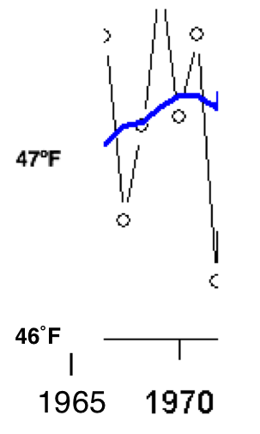
Massachusetts Average Temperature
This graph shows the average temperature in Massachusetts over a very short time – less than 10 years.

Slide 8
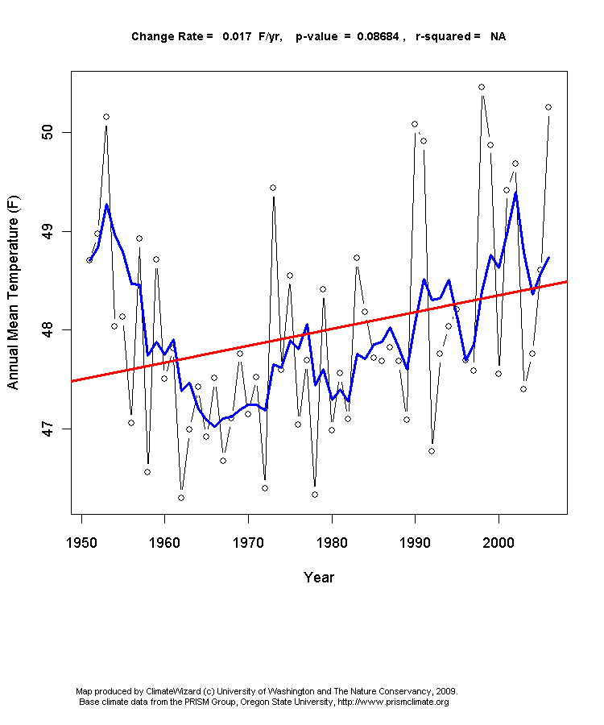
This is the same graph, but rather than around 8 years, it shows the average temperatures for closer to 60 years. Where does the first graph fit in?

Slide 9
When you’re studying climate, you want as many years of data as possible. That way you’re less likely get the wrong picture.

