Slide 1
The Climate Lab
Lesson 4

Slide 2
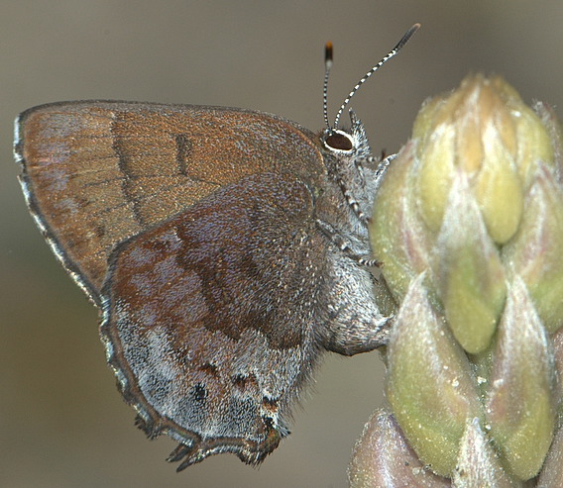
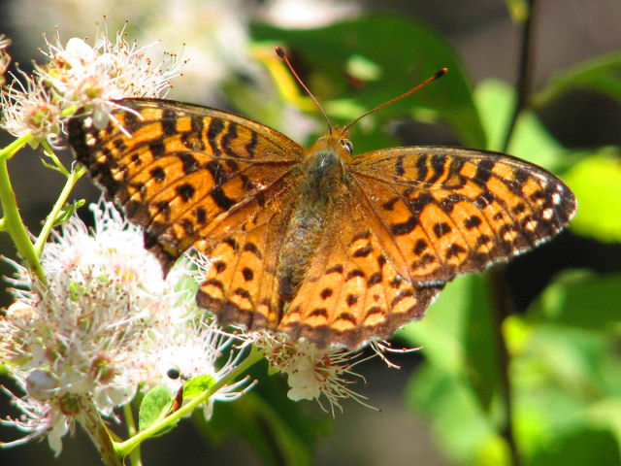
Trends around New England

Slide 3
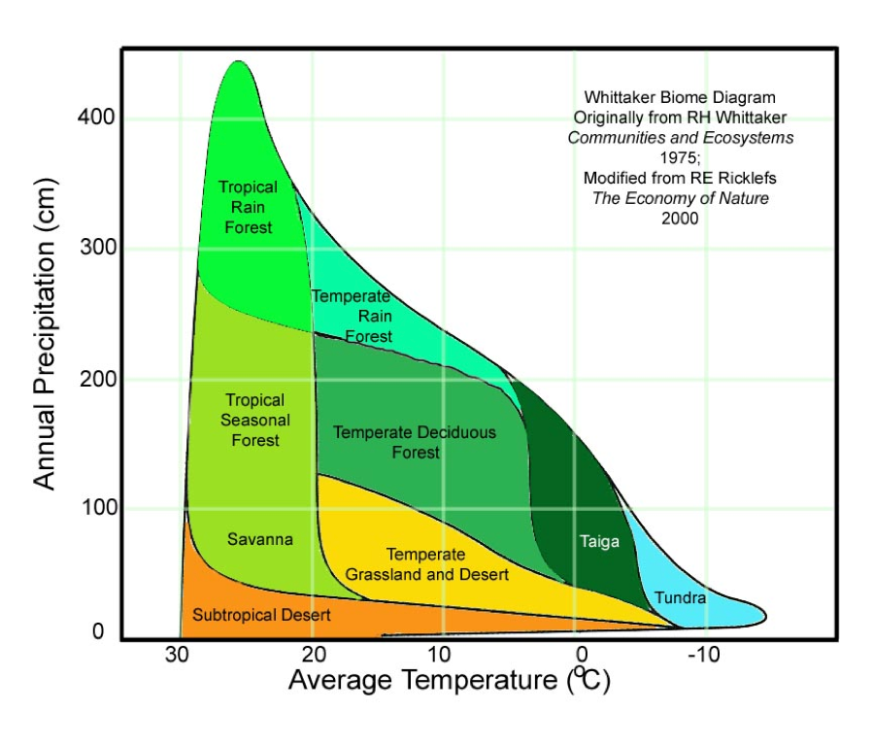
The Whittaker Biome Diagram
This diagram is a model that shows us how different ecosystem types around the world are dependent upon on temperature and precipitation.

